Slide 1


Gender Awareness in Akan Culture: Embracing Equality and Tradition
This essay examines the role of gender awareness within the Akan culture of Ghana, showcasing how traditional gender roles and practices are evolving to promote equality and social cohesion. By exploring the matrilineal inheritance system, women's roles in commerce, and contemporary shifts in gender dynamics, we can understand the critical importance of gender awareness in fostering a balanced and progressive society.

Slide 2
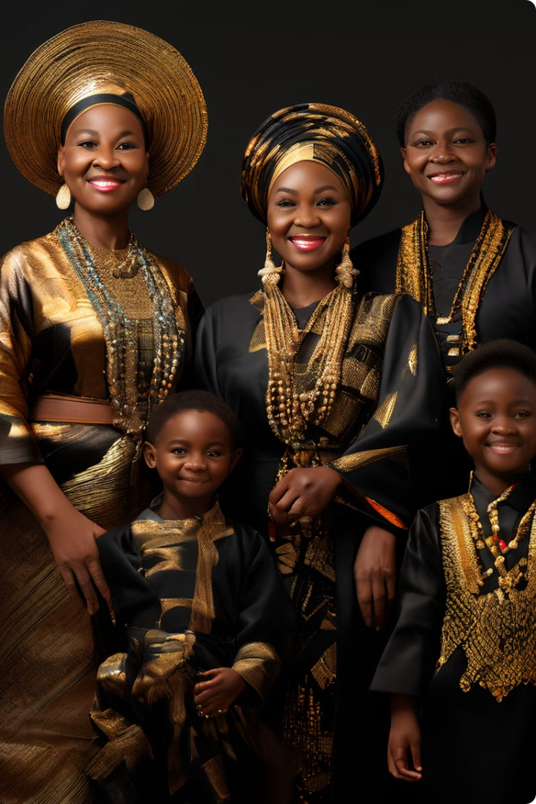
Matrilineal Inheritance System
The Akan people of Ghana, known for their rich cultural heritage and complex social structures, have a unique approach to gender roles that provides valuable insights into the importance of gender awareness. Traditionally, the Akan culture features a matrilineal system of inheritance, which inherently acknowledges the significance of women.
Lineage and Inheritance
The Akan's matrilineal system is a distinctive aspect of their culture, where lineage and inheritance pass through the mother's line. This system inherently elevates the status of women within the family and community.
Contrast to Patrilineal Societies
Unlike patrilineal societies, where inheritance and leadership typically pass through the male line, the Akan system ensures that women have a critical role in preserving family heritage and continuity.

Slide 3

Significance of Matrilineal Inheritance
This matrilineal practice highlights the importance of women as custodians of lineage and property, promoting respect and recognition of their roles. It ensures that women have a voice in family decisions and the distribution of wealth, contributing to gender balance and social stability.
1
Women's Role in Family Decisions
The matrilineal system ensures that women have a voice in family decisions and the distribution of wealth.
2
Gender Balance and Social Stability
This system contributes to gender balance and social stability by ensuring that women have a voice in family decisions and the distribution of wealth.

Slide 4
Women's Roles in Commerce
Akan women have traditionally been influential in trade and commerce. Market women, often organized in associations, play a significant role in the local economy, controlling substantial aspects of the retail and wholesale trade.
Market Queens
Economic Empowerment
Community Prosperity
These women, known as "market queens," wield considerable economic power and influence within their communities.
Their active participation in the economy not only supports their families but also contributes to the community's overall prosperity.
The prominence of women in commerce illustrates the economic empowerment of women in Akan society.

Slide 5

Contemporary Shifts in Gender Dynamics
Despite these traditional practices, contemporary Akan society faces challenges related to gender equality, such as access to education and professional opportunities for women. Gender awareness initiatives are increasingly addressing these issues by promoting women's education and leadership.
1
Educational Initiatives
Programs aimed at improving girls' education have seen success in Akan regions. By ensuring that girls have equal access to education, these initiatives help break down barriers and open opportunities for women in various professional fields.
2
Political and Leadership Roles
Gender awareness has also led to more women participating in political and leadership roles. Efforts to encourage women's involvement in local and national governance are gradually changing traditional gender dynamics, ensuring that women's voices are heard in decision-making processes.
3
Challenges and Progress
While significant progress has been made, challenges remain, such as addressing deeply rooted gender biases and ensuring equal opportunities for women in all aspects of life. Cultural practices that disadvantage women still exist, requiring continuous advocacy and education to promote gender equality.

Slide 6




Community Engagement
Community-based organizations and gender advocacy groups play a vital role in raising awareness and challenging harmful practices. By engaging both men and women in these efforts, communities can work together to promote gender equality and create a more inclusive society.
Community-Based Organizations
Gender Advocacy Groups
Engaging Men and Women
Gender advocacy groups play a vital role in raising awareness and challenging harmful practices.
Community-based organizations play a vital role in raising awareness and challenging harmful practices.
By engaging both men and women in these efforts, communities can work together to promote gender equality and create a more inclusive society.

Slide 7

Conclusion
The Akan culture of Ghana exemplifies how traditional practices can coexist with gender awareness to promote social harmony and development. By recognizing the importance of women through matrilineal inheritance, economic participation, and contemporary gender initiatives, Akan society demonstrates that gender equality is essential for sustainable progress.
Matrilineal Inheritance
Economic Participation
Contemporary Gender Initiatives
Preserves heritage and elevates women's status.
Empowers women and contributes to community prosperity.
Address challenges and promote equal opportunities for women.

Slide 8




Embracing Gender Awareness
Embracing gender awareness within cultural contexts not only preserves heritage but also fosters a more just and prosperous future for all. The Akan culture of Ghana provides a valuable example of how traditional practices can evolve to embrace gender equality, creating a society that values the contributions of all its members.
Preserving Heritage
Embracing gender awareness within cultural contexts not only preserves heritage.
Fostering a Just Future
Embracing gender awareness within cultural contexts also fosters a more just and prosperous future for all.
The Akan Example
The Akan culture of Ghana provides a valuable example of how traditional practices can evolve to embrace gender equality, creating a society that values the contributions of all its members.

